Slide 1
Fiber-Free Treatment for Attenuation of HVAC Noise ME-2004 Duct Treatment Design
Bryce Geesey - Ben Masters - Nitin Pauletti - Jinghe Yu

Slide 2
Design Characteristics
Goals + Constraints
Assumptions
Frequency Analysis Range
100-1k Hz
Locally Reacting
Impedance is independent of angle of incidence
Modal Analysis
Find the characteristics of the first two modes of the system
Purely real impedance film
Thin, massless and limp (resistive only)
2D propagation
No airflow in duct

Slide 3
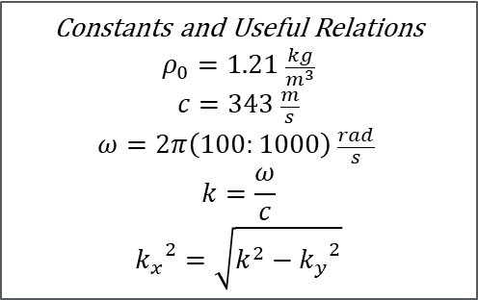
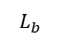
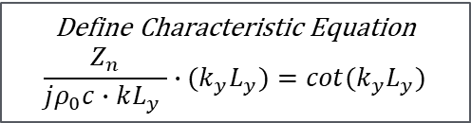
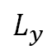
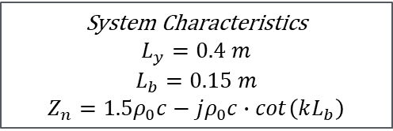
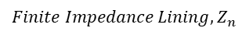
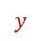
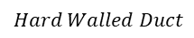
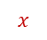
System Illustration and Modeling
System Characteristics
$$L_{y}=0.4 m$$
$$L_{b}=0.15 m$$
$$Z_{n}=1.5ρ_{0}c−jρ_{0}c∙cot\left(kL_{b}\right)$$
$$L_{b}$$
Constants and Useful Relations
$$ρ_{0}=1.21 \frac{kg}{m^{3}}$$
$$c=343 \frac{m}{s}$$
$$ω=2π\left(100:1000\right) \frac{rad}{s}$$
$$k=\frac{ω}{c}$$
$${k_{x}}^{2}=\sqrt{k^{2}−{k_{y}}^{2}}$$
$$Finite Impedance Lining,Z_{n}$$
$$L_{y}$$
$$y$$
$$Hard Walled Duct$$
$$x$$
Define Characteristic Equation
$$\frac{Z_{n}}{jρ_{0}c∙kL_{y} }∙{(k}_{y}L_{y})=cot(k_{y}L_{y})$$

Slide 4
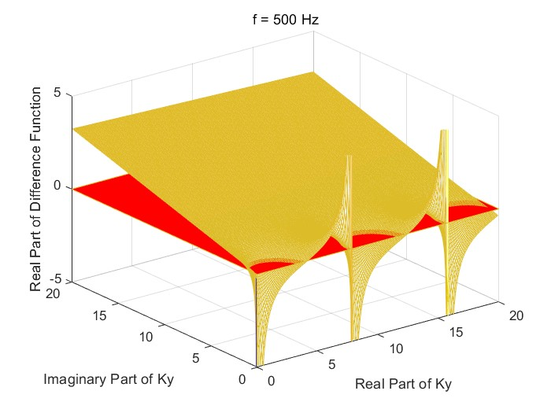
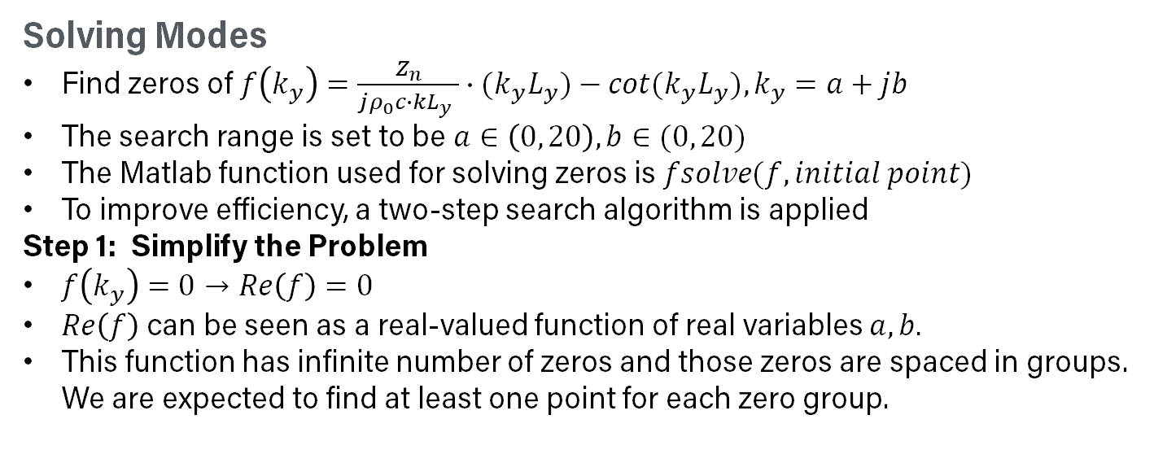
Part i) Complex Axial Wavenumber Solutions
Solving Modes
Find zeros of $f\left(k_{y}\right)=\frac{Z_{n}}{jρ_{0}c∙kL_{y} }∙{(k}_{y}L_{y})−cot(k_{y}L_{y}), k_{y}=a+jb$
The search range is set to be $a∈\left(0, 20\right), b∈(0, 20)$
The Matlab function used for solving zeros is $fsolve(f,initial point)$
To improve efficiency, a two-step search algorithm is applied
Step 1: Simplify the Problem
$f\left(k_{y}\right)=0→Re\left(f\right)=0$
$Re\left(f\right)$ can be seen as a real-valued function of real variables $a, b.$
This function has infinite number of zeros and those zeros are spaced in groups. We are expected to find at least one point for each zero group.

Slide 5
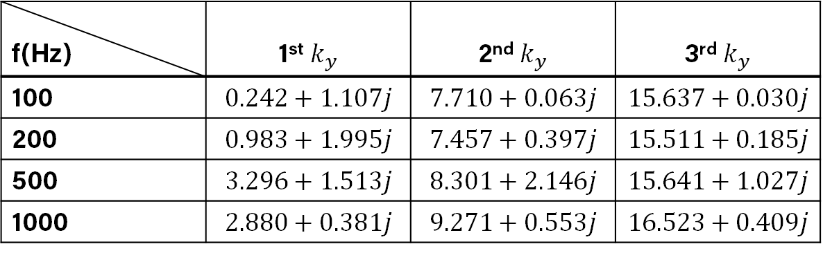
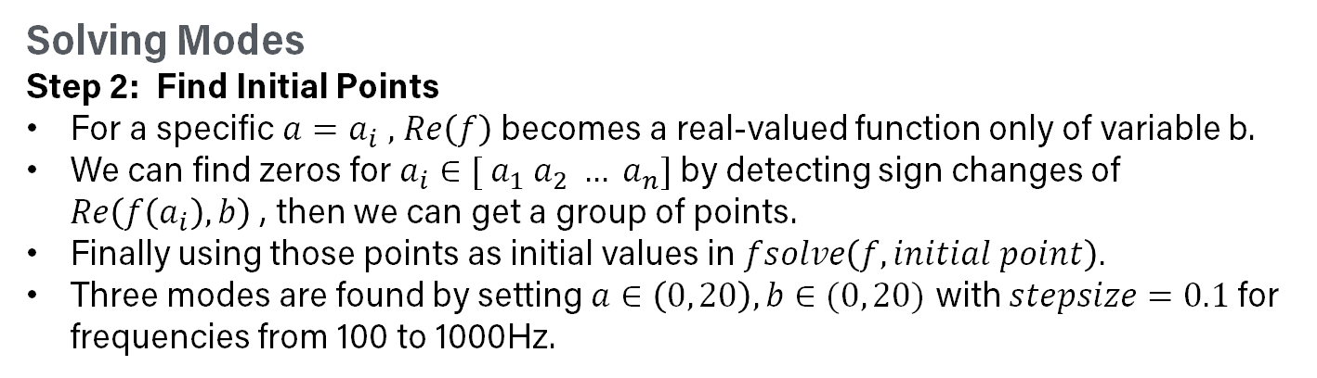
Part i) Complex Axial Wavenumber Solutions
Solving Modes
Step 2: Find Initial Points
For a specific $a=a_{i} ,$ $Re\left(f\right)$ becomes a real-valued function only of variable b.
We can find zeros for $a_{i}∈{[ a_{1} a_{2} … a}_{n}]$by detecting sign changes of $Re\left(f\left(a_{i}\right),b\right)$ , then we can get a group of points.
Finally using those points as initial values in $fsolve\left(f,initial point\right).$
Three modes are found by setting $a∈\left(0, 20\right), b∈(0, 20)$ with $stepsize=0.1$ for frequencies from 100 to 1000Hz.
f(Hz) | 1st $k_{y}$ | 2nd $k_{y}$ | 3rd $k_{y}$
100 | $$0.242+1.107j$$ | $$7.710+0.063j$$ | $$15.637+0.030j$$
200 | $$0.983+1.995j$$ | $$7.457+0.397j$$ | $$15.511+0.185j$$
500 | $$3.296+1.513j$$ | $$8.301+2.146j$$ | $$15.641+1.027j$$
1000 | $$2.880+0.381j$$ | $$9.271+0.553j$$ | $$16.523+0.409j$$

Slide 6
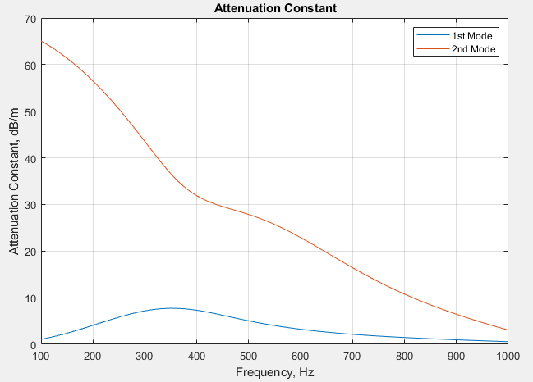
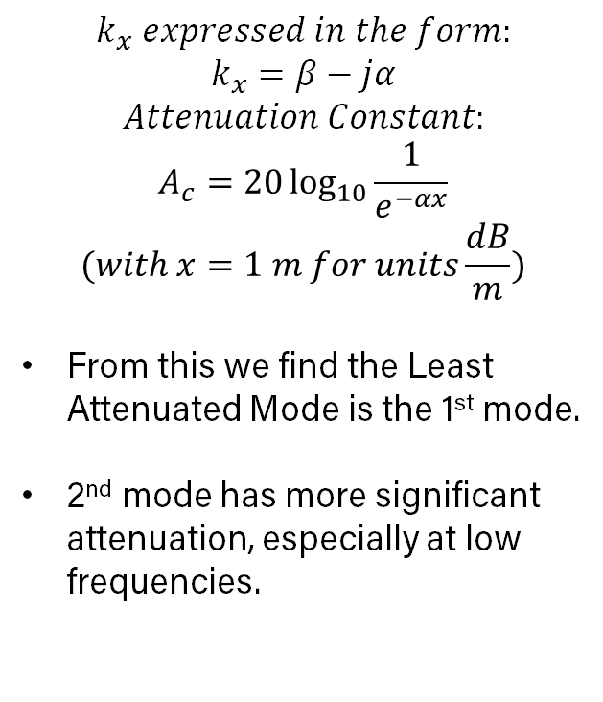
Part ii-iii) Attenuation Constant & Least Attenuated Mode
$$k_{x} expressed in the form:$$
$$k_{x}=β−jα$$
$$Attenuation Constant:$$
$$A_{c}=20\log_{10}{\frac{1}{e^{−αx}}}$$
$$(with x=1 m for units\frac{dB}{m})$$
From this we find the Least Attenuated Mode is the 1st mode.
2nd mode has more significant attenuation, especially at low frequencies.

Slide 7
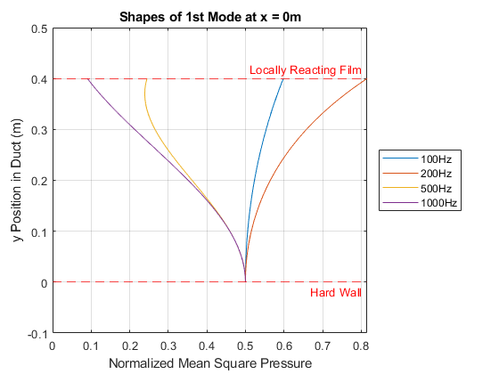
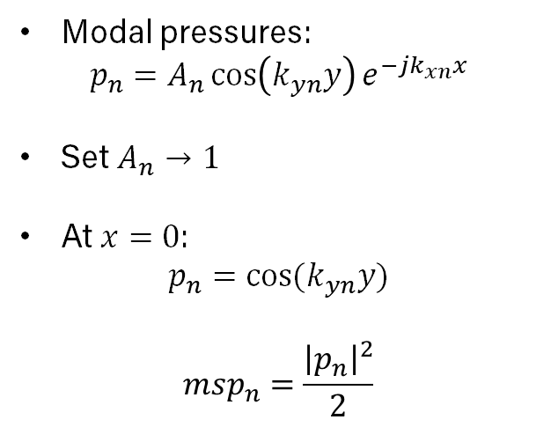
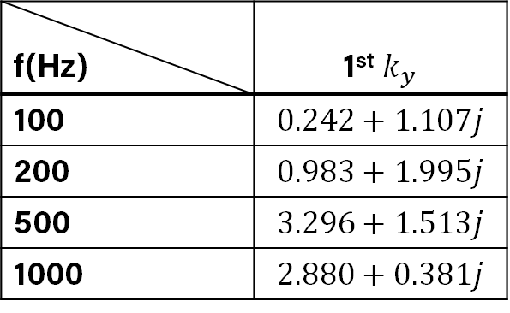
Part iv) Mode Shape Evolution
Modal pressures:
$$p_{n}=A_{n}\cos\left(k_{yn}y\right)e^{−jk_{xn}x}$$
Set $A_{n}→1$
At $x=0$:
$$p_{n}=cos⁡(k_{yn}y)$$
$$msp_{n}=\frac{{\left|p_{n}\right|}^{2}}{2}$$
f(Hz) | 1st $k_{y}$
100 | $$0.242+1.107j$$
200 | $$0.983+1.995j$$
500 | $$3.296+1.513j$$
1000 | $$2.880+0.381j$$
Notes:
First two: imaginary part that is more than real part (250 one is larger than 100 one), larger pressure?
If imaginary part is > real, bigger alpha corresponds to more pressure
If imaginary part is < real, smaller alpha corresponds to less pressure

Slide 8
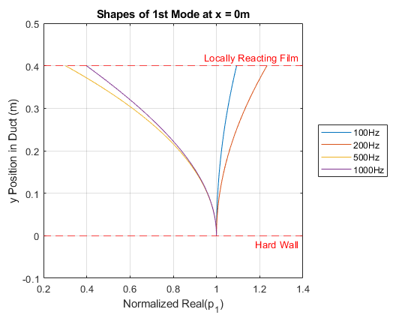
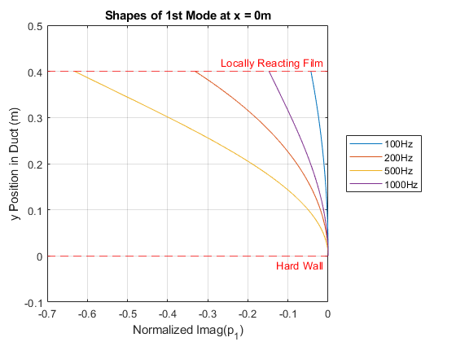
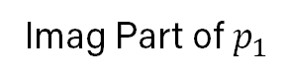
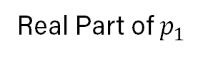
Part iv) Mode Shape Evolution cont.
Real Part of $p_{1}$
Imag Part of $p_{1}$
Notes:
First two: imaginary part that is more than real part (250 one is larger than 100 one), larger pressure?
If imaginary part is > real, bigger alpha corresponds to more pressure
If imaginary part is < real, smaller alpha corresponds to less pressure

Slide 9
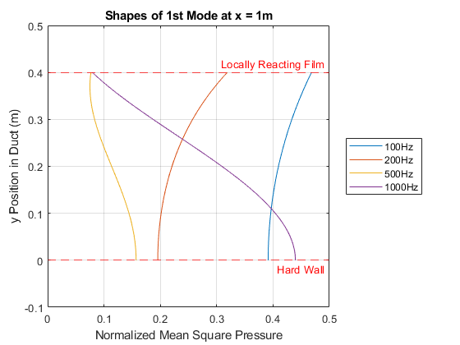
Part iv) Mode Shape Evolution cont.
Notes:
At x = 0, both 1st and second mode have all starting at same value at hard wall
On first mode, 500 is most attenuated
Pressure getting larger, gradient positive and velocity in y-dir negative (backing space acting like resonator?)

Slide 10
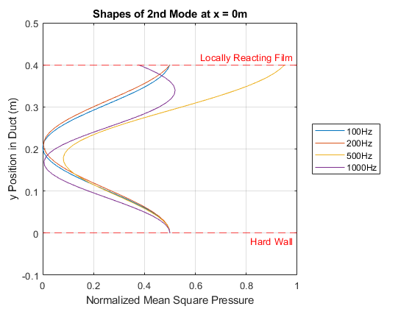
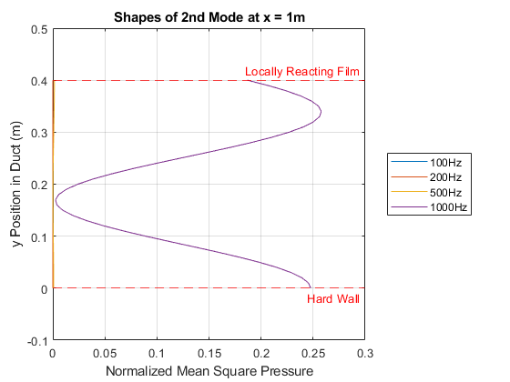
Part iv) Mode Shape Evolution cont.
Notes:
At x = 0, both 1st and second mode have all starting at same value at hard wall
Can see that 2nd mode is the most attenuated, as the MSP is the lowest. Also, 100 hz is most attenuated and 1000 is least (verified with plot from slide 6)
Pressure getting larger, gradient positive and velocity negative (backing space acting like resonator?)

Slide 11
Thank You
Questions?

